Slide 1
EC3357:Machine Learning
Lecture 6: Support Vector Machine

Slide 2
Linear Separators
Binary classification can be viewed as the task of separating classes in feature space:
w^{T}x + b = 0
w^{T}x + b > 0
w^{T}x + b < 0
f(x) = sign(w^{T}x + b)

Slide 3
Linear Separators
Which of the linear separators is optimal?

Slide 4
Introduction
“Support Vector Machine” (SVM) is a supervised machine learning algorithm that can be used for both classification or regression challenges.
However, it is mostly used in classification problems.
It belongs to the category of the deterministic algorithm (given a particular input, will always produce the same output).
The objective of the support vector machine algorithm is to find a hyperplane in an N-dimensional space(N — the number of features) that distinctly classifies the data points.
In the SVM algorithm, we plot each data item as a point in n-dimensional space with the value of each feature being the value of a particular coordinate. Then, we perform classification by finding the hyper-plane that differentiates the two classes very well (look at the below snapshot).

Slide 5
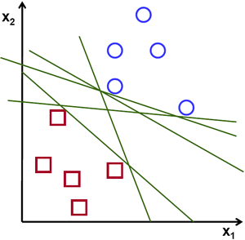
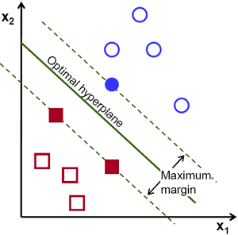
Possible hyperplanes
Separate the two classes of data points, there are many possible hyperplanes that could be chosen. Our objective is to find a plane that has the maximum margin, i.e the maximum distance between data points of both classes. Maximizing the margin distance provides some reinforcement so that future data points can be classified with more confidence.

Slide 6
How SVM works ?

Slide 7
What is a classification analysis?
Let’s consider that we have a population composed of 50%-50% Males and Females.
Using a sample of this population, we want to create some set of rules which will guide us the gender class for rest of the population. Using this algorithm, we intend to build a program which can identify whether a person is a Male or a Female.
This is a sample problem of classification analysis. Using some set of rules, we will try to classify the population into two possible segments. For simplicity, let’s assume that the two differentiating factors identified are : Height of the individual and Hair Length. Following is a scatter plot of the sample.

Slide 8
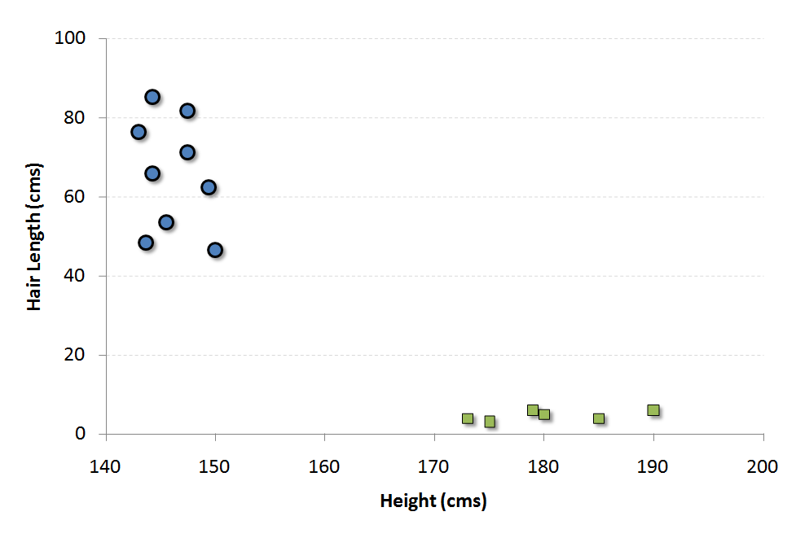

Slide 9
The blue circles in the plot represent females and green squares represents male. A few expected insights from the graph are :
1. Males in our population have a higher average height.
2. Females in our population have longer scalp hairs.
If we were to see an individual with height 180 cms and hair length 4 cms, our best guess will be to classify this individual as a male. This is how we do a classification analysis.

Slide 10
Support Vector and what is SVM
Support Vectors are simply the co-ordinates of individual observation. For instance, (150,45) is a support vector which corresponds to a female.
Support Vector Machine is a frontier which best segregates the Male from the Females. In this case, the two classes are well separated from each other, hence it is easier to find a SVM.

Slide 11
Sample Program (Linear SVM)
Import the necessary libraries
Create a sample dataset
Split the data into training and testing sets
Create and train the SVM model
Make predictions and evaluate the model
Test with a new sample

Slide 12
Types of SVM
There are basically two types of SVM:
1- Linear SVM– It creates a line or a hyperplane which separates the data into classes. Here the dataset is linearly separable.
2- Non-linear SVM- It is used to classifying a non-linearly separable dataset.

Slide 13
Linear SVM
Linear SVM is used to separate the dataset into two classes by creating a hyperplane.
Draw all the possible lines which separate the two classes and then pick those lines which have the highest margin.
Choose only that line which has the widest margin that separates the two groups or classes.
SVM models try to maximize the distance between the two classes by creating a well-defined decision boundary.

Slide 14
Non-linear SVM
Non-linear SVM is also called Kernel SVM and it is used to map the dataset into the higher dimensional space.
There are two ways to solve non-linear problem
1- Map the dataset into some higher dimensional feature space where the data points become separable.
2- By adding the polynomial features and similarity features.

Slide 15
Non-linear and inseparable planes
Some problems can’t be solved using linear hyperplane.
In such situation, SVM uses a kernel trick to transform the input space to a higher dimensional space as shown on the right.
The data points are plotted on the x-axis and z-axis (Z is the squared sum of both x and y: z=x^2=y^2).
Now you can easily segregate these points using linear separation.

Slide 16
Non-linear and inseparable planes

Slide 17
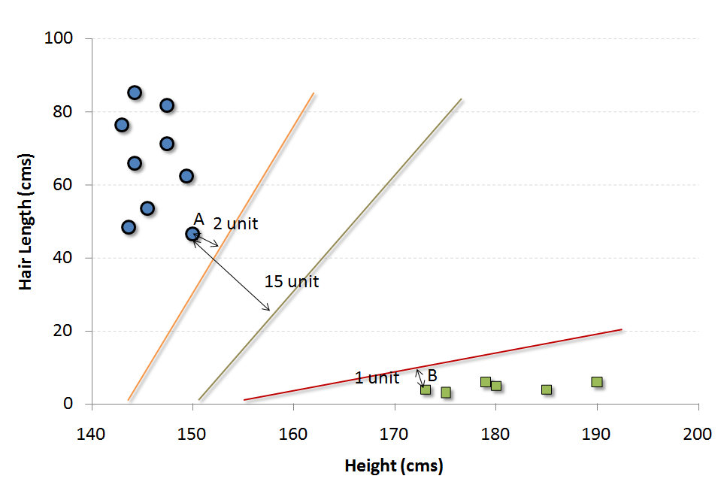
Find the Support Vector Machine
There are many possible frontier which can classify the problem in hand. Following are the three possible frontiers.

Slide 18
How do we decide which is the best frontier for this particular problem statement?
The easiest way to interpret the objective function in a SVM is to find the minimum distance of the frontier from closest support vector (this can belong to any class). For instance, orange frontier is closest to blue circles. And the closest blue circle is 2 units away from the frontier. Once we have these distances for all the frontiers, we simply choose the frontier with the maximum distance (from the closest support vector). Out of the three shown frontiers, we see the black frontier is farthest from nearest support vector (i.e. 15 units).

Slide 19
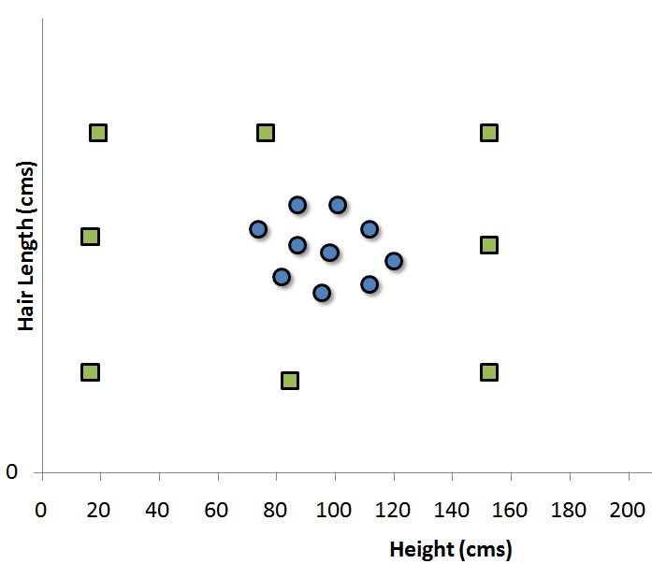
What if we do not find a clean frontier which segregates the classes?
What if the distribution looked something like as follows :

Slide 20
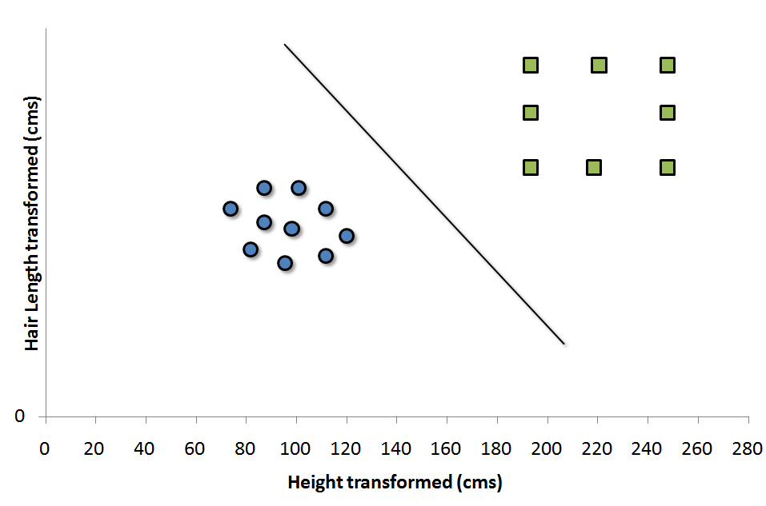
In such cases, we do not see a straight line frontier directly in current plane which can serve as the SVM. In such cases, we need to map these vector to a higher dimension plane so that they get segregated from each other. Such cases will be covered once we start with the formulation of SVM. We can visualize that such transformation will result into following type of SVM.
Each of the green square in original distribution is mapped on a transformed scale. And transformed scale has clearly segregated classes. Many algorithms have been proposed to make these transformations and some of which will be discussed.

Slide 21
Sample Program 2
Import necessary libraries
Create a sample non-linear dataset
Create and train the SVM model with RBF kernel
Plot the decision boundary and the data points:
Test the model with new data:

Slide 22
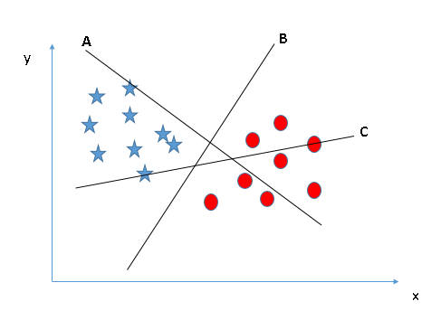
How can we identify the right hyper-plane?
Scenario-1
Here, we have three hyper-planes (A, B, and C). Now, identify the right hyper-plane to classify stars and circles.
“Select the hyper-plane which segregates the two classes better”. In this scenario, hyper-plane “B” has excellently performed this job.

Slide 23
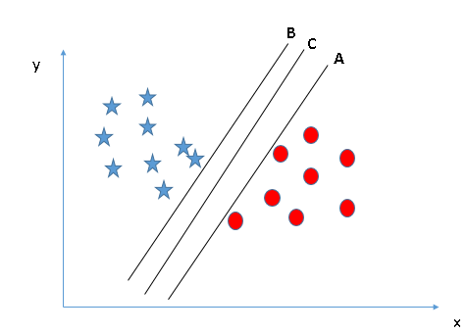
Scenario-2
Here, we have three hyper-planes (A, B, and C) and all are segregating the classes well. Now, How can we identify the right hyper-plane?

Slide 24
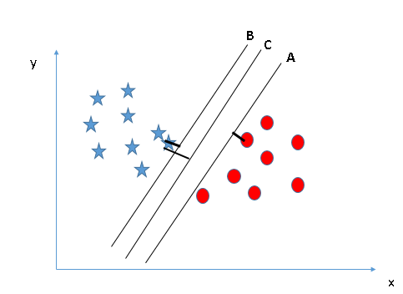
Here, maximizing the distances between nearest data point (either class) and hyper-plane will help us to decide the right hyper-plane. This distance is called as Margin. Let’s look at the below snapshot:
In this case we can see that the margin for hyper-plane C is high as compared to both A and B. Hence, we name the right hyper-plane as C. Another lightning reason for selecting the hyper-plane with higher margin is robustness. If we select a hyper-plane having low margin then there is high chance of miss-classification.

Slide 25
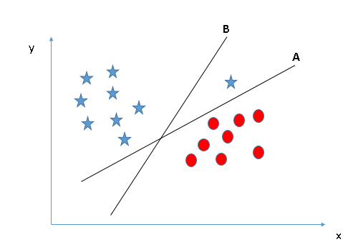
Scenario-3
In this case SVM selects the hyper-plane which classifies the classes accurately prior to maximizing margin. Here, hyper-plane B has a classification error and A has classified all correctly. Therefore, the right hyper-plane is A.

Slide 26
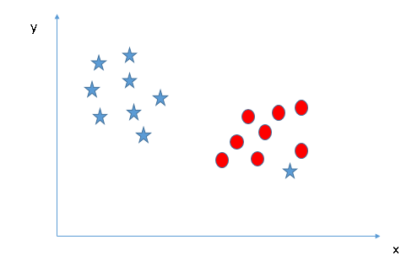
Scenario-4
In the below graph, we are unable to segregate the two classes using a straight line, as one of the stars lies in the territory of other(circle) class as an outlier.

Slide 27
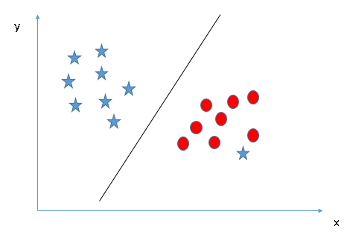
One star at other end is like an outlier for star class. The SVM algorithm has a feature to ignore outliers and find the hyper-plane that has the maximum margin. Hence, we can say, SVM classification is robust to outliers.

Slide 28
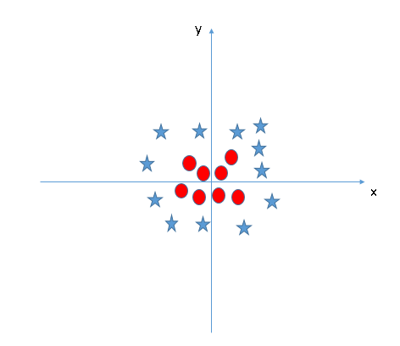
Scenario-5
In the scenario below, we can’t have linear hyper-plane between the two classes, so how does SVM classify these two classes? Till now, we have only looked at the linear hyper-plane.

Slide 29
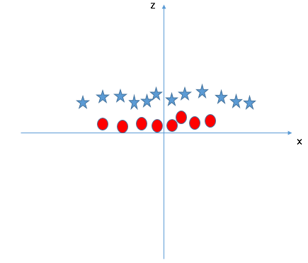
SVM can solve this problem. Easily! It solves this problem by introducing additional feature. Here, we will add a new feature z=x^2+y^2. Now, let’s plot the data points on axis x and z:
In this, points to consider are:
All values for z would be positive always because z is the squared sum of both x and y
In the original plot, red circles appear close to the origin of x and y axes, leading to lower value of z and star relatively away from the origin result to higher value of z.

Slide 30
SVM algorithm has a technique called the kernel trick.
The SVM kernel is a function that takes low dimensional input space and transforms it to a higher dimensional space i.e. it converts not separable problem to separable problem.
It is mostly useful in non-linear separation problem. Simply put, it does some extremely complex data transformations, then finds out the process to separate the data based on the labels or outputs you’ve defined.

Slide 31
Pros and Cons associated with SVM
Pros:
It works really well with a clear margin of separation
It is effective in high dimensional spaces.
It is effective in cases where the number of dimensions is greater than the number of samples.
It uses a subset of training points in the decision function (called support vectors), so it is also memory efficient.
Cons:
It doesn’t perform well when we have large data set because the required training time is higher
It also doesn’t perform very well, when the data set has more noise i.e. target classes are overlapping
SVM doesn’t directly provide probability estimates, these are calculated using an expensive five-fold cross-validation. It is included in the related SVC method of Python scikit-learn library.

Slide 32
Example: SVM using Python
https://www.dataspoof.info/post/what-is-support-vector-machine-learn-to-implement-svm-in-python/
https://towardsdatascience.com/support-vector-machine-introduction-to-machine-learning-algorithms-934a444fca47
https://www.javatpoint.com/machine-learning-support-vector-machine-algorithm
https://mitu.co.in/wp-content/uploads/2022/04/24.-Support-Vector-Machine.pdf

